Slide 1





ADVANCED CARDIAC LIFE SUPPORT(ACLS)
Dr. Samad Shams Vahdati, MD
Professor of emergency medicine

Slide 2
ADVANCED CARDIAC LIFE SUPPORT
Advanced cardiac life support or advancedcardiovascular life support (ACLS) refers to a set of clinical interventions for the urgent treatment of cardiac arrest and other life-threatening medical emergencies, as well as the knowledge and skills to deploy those interventions.

Slide 3
ACLS is a series of evidence based responses simple enough to be committed to memory and recall under moments of stress.
AMERICAN HEART ASSOCIATION (AHA) protocols are considered to be the GOLD standard ACLS protocols
It gets reviewed every 5 year, now latest advancements in
ecgguidelines.health.org

Slide 4
IMPORTANCE OF BLS IN ACLS
ACLS is built heavily upon the foundation of BLS

Slide 5
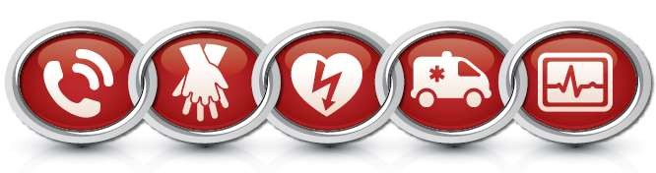
AHA Adult Chain of Survival
Immediate recognition of cardiac arrest and activation of the emergency response system
Early CPR with an emphasis on chest compressions
Rapid defibrillation
Effective advanced life support
Integrated post–cardiac arrest care

Slide 6
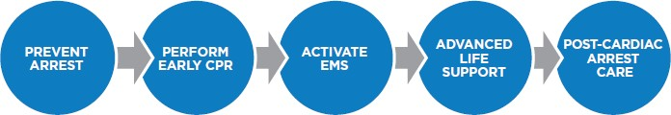
AHA PEDIATRIC Chain of Survival

Slide 7
COMPONENT OF HIGH QUALITY CPR IN BLS
Scene safety:
1. Make sure the environment is safe for rescuers and victim
Recognition of cardiac arrest:
Check for responsiveness
No breathing or only gasping ( ie, no normal breathing)
No definite pulse felt within 10 secs ( Carotid or femoral pulse)
(Breathing and pulse check can be performed
simultaneously within 10 secs)

Slide 8
Activation of emergency response system:
If alone with no mobile phone, leave the victim to activate the emergency response system and get the AED before beginning CPR
Otherwise, send someone and begin CPR immediately; use the AED as soon as it is available

Slide 9
WITNESSED VS UNWITNESSED
WITNESSED
  IF ALONE
    ACTIVATE EMS
    THEN CPR
  IF 2 RESCUERS
    START CPR
    SECOND ONE – ACTIVATE EMS
UNWITNESSED
  START CPR
  GIVE FOR 2 MINS
  ACTIVATE EMS

Slide 10
Chest compression-
Adult- 30:2
Children or infant- 30:2 if one rescuer
15:2 if more than one rescuer
Compression rate:
100-120/ min
Compression depth:
Adult- at least 5 cm
Children or infant- at least 1/3rd AP diameter of chest

Slide 11
Hand placement:
Adult - 2 hands on the lower half of the sternum Children – 1 or 2 hands on the lower half of the sternum
Infants – 2 fingers or 2 thumb defending of the number of rescuers
Chest recoil:
allow full recoil of chest after each compression; do not lean on the chest after each compression.
Minimizing interruption: Limit interruptions in chest
compressions to less than 10 secs.

Slide 12
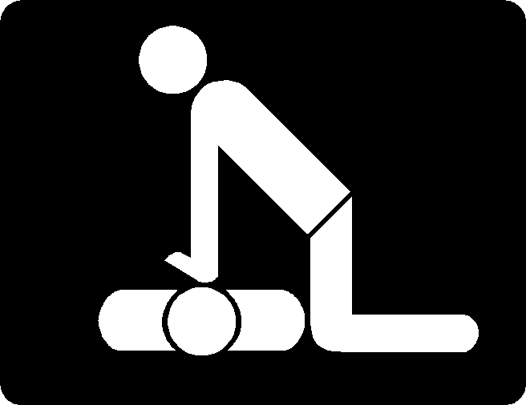
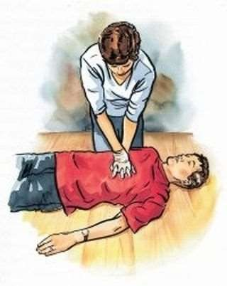

Slide 13
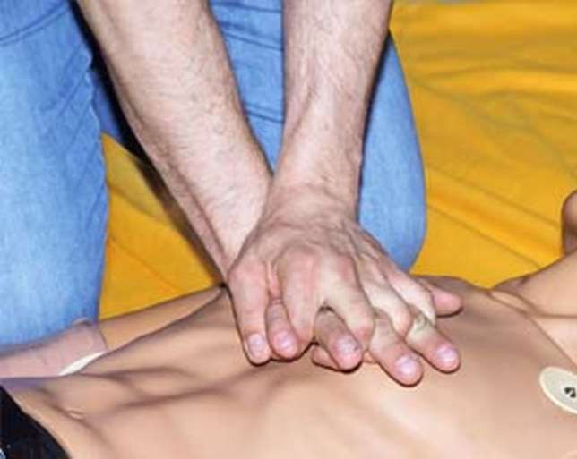

Slide 14
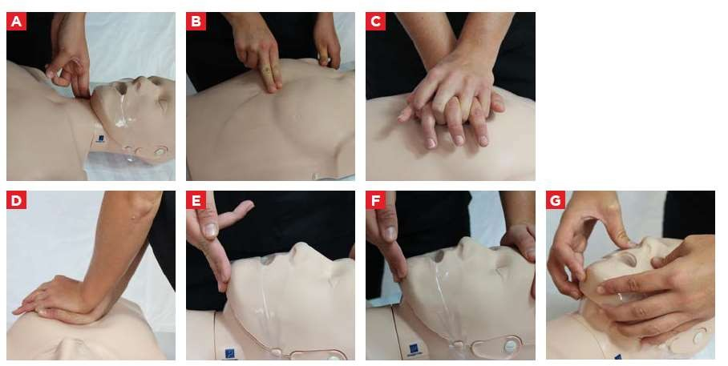

Slide 15
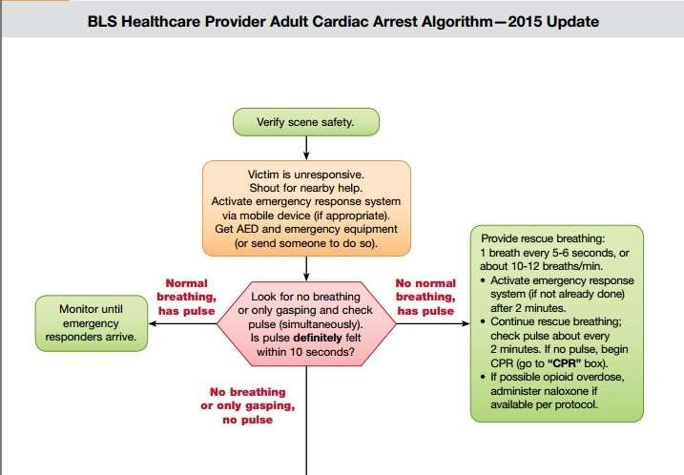

Slide 16
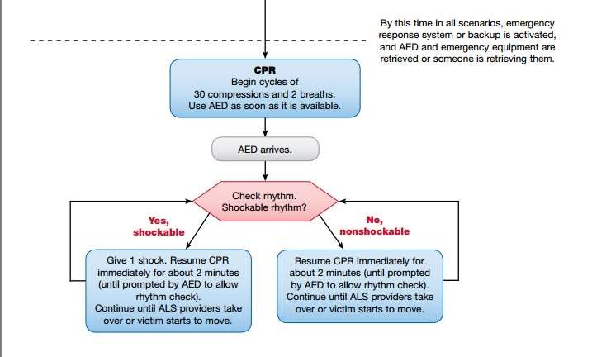

Slide 17
Adult advanced cardiovascular life support

Slide 18
Shockable
VT
Monomorphic or polymorphic
VF
Fine or Coarse VF

Slide 19
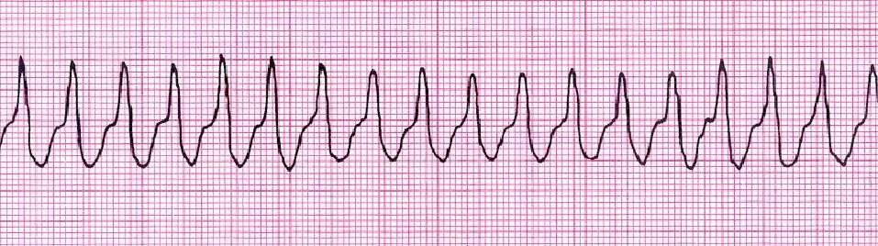
Ventricular tachycardia
.R-R interval usually regular, not always
QRS not preceded by p wave.
Wide and bizzare QRS.
Difficult to find seperation between QRS and T wave
Rate=100-250bpm

Slide 20
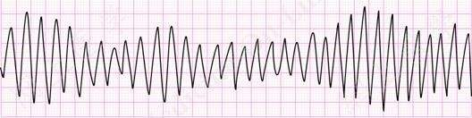
Torsades de Pointes
Ttwisting of points, is a distinctive form of polymorphic ventricular tachycardia characterized by a gradual change in the amplitude and twisting of the QRS complexes around the isoelectric line.
Rate cannot be determined.

Slide 21
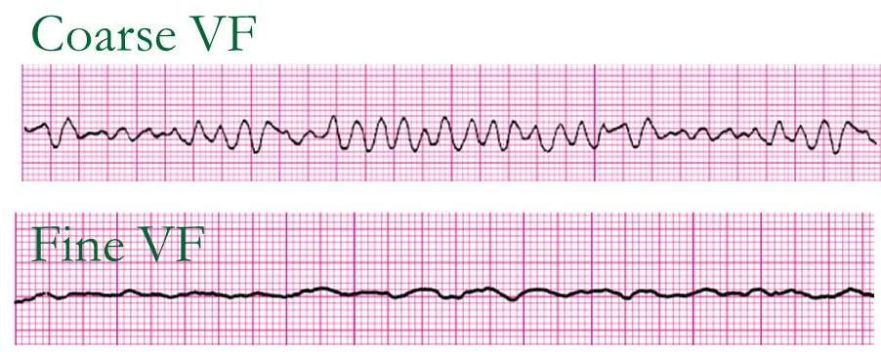
Ventricular fibrillation
A severely abnormal heart rhythm (arrhythmia) that can
be life-threatening.
No identifiable P, QRS or T wave Emergency- requires Basic Life Support
Rate cannot be discerned, rhythm unorganized

Slide 22
Unshockable
Asystole
PEA- pulseless
electrical activity or EMD-
electromechanical
dissociation

Slide 23
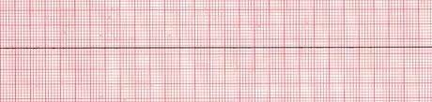
Asystole
a state of no cardiac electrical activity, hence no contractions of the myocardium and no cardiac output or blood flow.
Rate, rhythm, p and QRS are absent

Slide 24
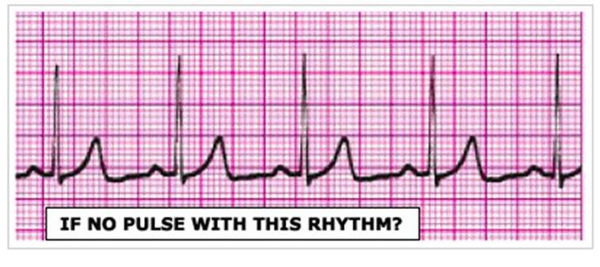
Pulseless electrical activity
Pulseless electrical activity (PEA)
unresponsiveness and no palpable pulse
some organized cardiac electrical activity.
previously referred to as electromechanical dissociation

Slide 25
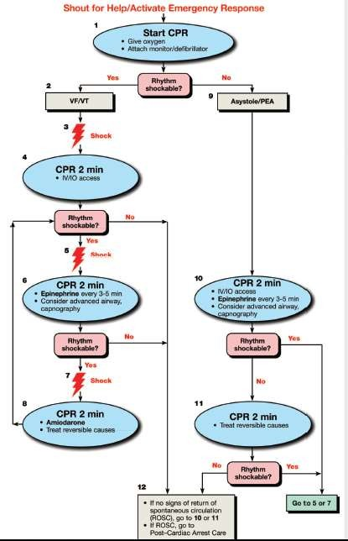

Slide 26
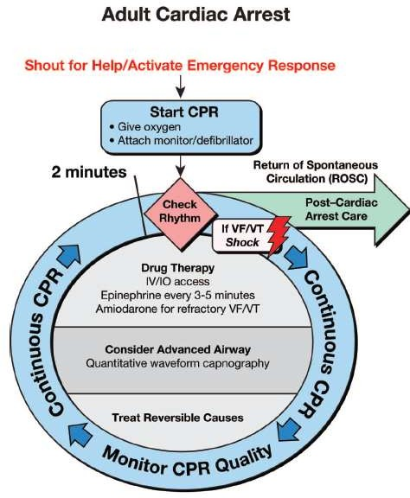

Slide 27
Deliver single defibrillitor shock
CPR-2 mins Check rhythm
Deliver single shock- if VT
/VF persist---CPR 2 mins and give EPINEPHRINE 1 mg
Continue CPR 2 min
Amiodarone/ Lidocaine/ Magnesium sulfate
Vt/ vf
Defibrillate: Drug---Shock---Drug---- Shock

Slide 28
Asystole/PEA
Continue CPR (Intubate and establish IV access)
Identify and RX reversible causes
Continue CPR if asystole/PEA

Slide 29
Treatable Causes of Cardiac
Arrest:
H’s
The H’s and T’s
T’s
Hypoxia
Hypovolemia
Hydrogen ion(acidosis)
Hypo-/hyperkalemia
Hypothermia
Toxins
Tamponade (cardiac) Tension pneumothorax
Thrombosis, pulmonary Thrombosis, coronary

Slide 30
DEFIBRILLATION

Slide 31
Defibrillation
Biphasic wave form: 120- 200 J
Monophasic wave form: 360 J
AED- device specific
Failure of a single adequate shock to restore a pulse should be followed by continued CPR and second shock delivered after five cycles of CPR

Slide 32
HOW TO USE DEFIBRILLATOR
SAFETY
If patient not intubated remove o2 delivery devices
If intubated either leave bag valve resuscitator attached to Et or remove it
If available use self adhesive defibrillation pads
Do not place over pacemakers
Remove transdermal patches.

Slide 33
PROCEDURE
Place sternal paddle over right of the sternum below clavicle
Place apical paddle in mid axillary line in 5th IC space
Switch on the defibrillator
Charge the defibrillator to 200J or 360J
Warn all other rescuers to stand clear- ‘ARE YOU CLEAR’
Visually check all are clear
Ensure yourself you are not touching patient or bed ‘I AM CLEAR’

Slide 34
Deliver shock
Restart cpr with out checking pulse.

Slide 35
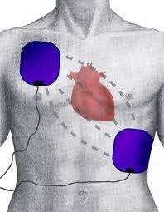
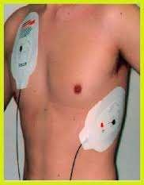

Slide 36
Automatic External Defibrillator
Switch on AED.
Attach electrode pads.
Place electrodes as that of manual one
Follow voice commands
Make sure no one in contact with patient
Push shock button.

Slide 37
1-Shock Protocol Versus 3- Shock Sequence
Evidence from 2 well-conducted pre/post design studies suggested significant survival benefit with the single shock defibrillation protocol compared with 3-stacked-shock protocols
If 1 shock fails to eliminate VF, the incremental benefit of another shock is low, and resumption of CPR is likely to confer a greater value than another shock

Slide 38
Airway and Ventilations
Opening airway – Head tilt, chin lift or jaw thrust, in addition explore the airway for foreign bodies, dentures and remove them.

Slide 39
Breathing devices
BASIC AIRWAYS
Oropharyngeal airway
Nasopharyngeal airway
•
Endotracheal tube
Laryngeal mask airway
Laryngeal tube
Esophageal tracheal tube
ADVANCED

Slide 40
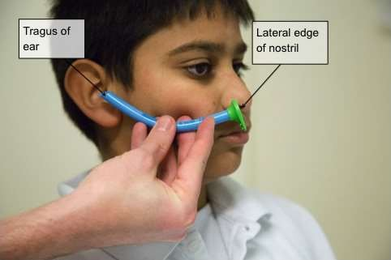
Nasopharyngeal airway

Slide 41
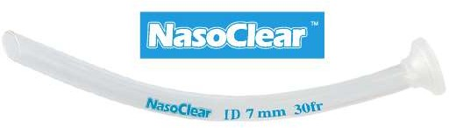

Slide 42
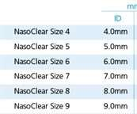
commonly 6–7 mm in an adult female and 7–8 mm for an
adult male

Slide 43
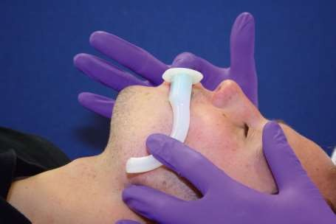
OROPHARYNGEAL AIRWAY

Slide 44
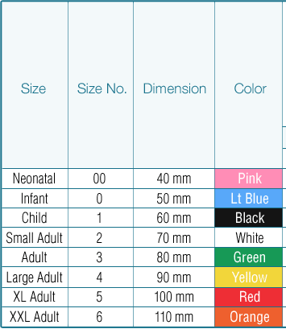
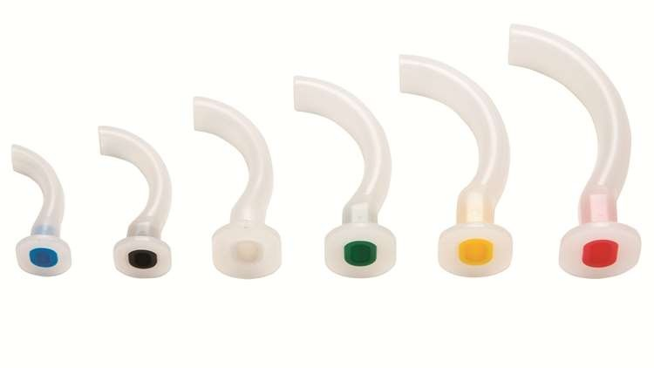

Slide 45
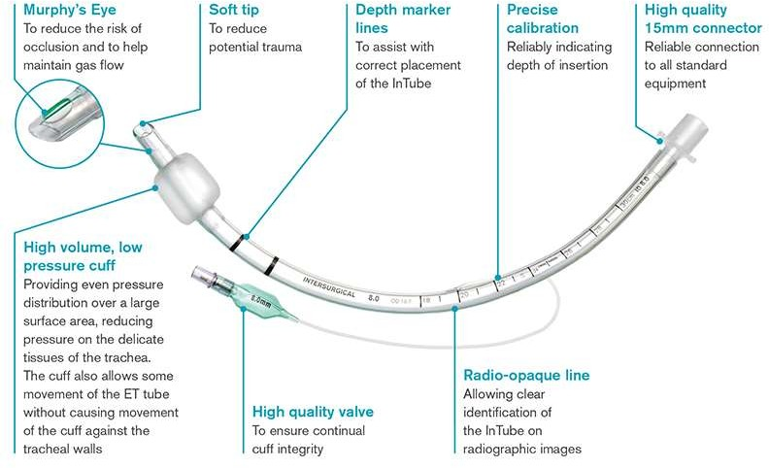
ENDOTRACHEAL TUBE

Slide 46
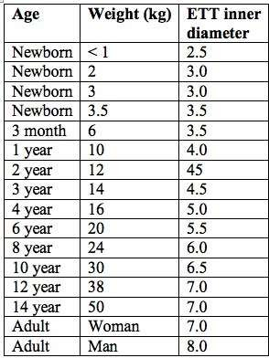

Slide 47
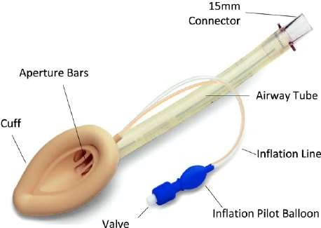
Laryngeal mask airway

Slide 48
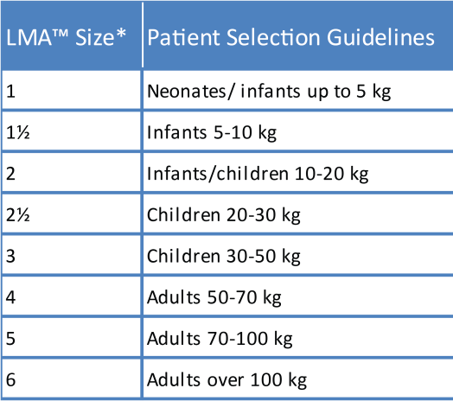

Slide 49
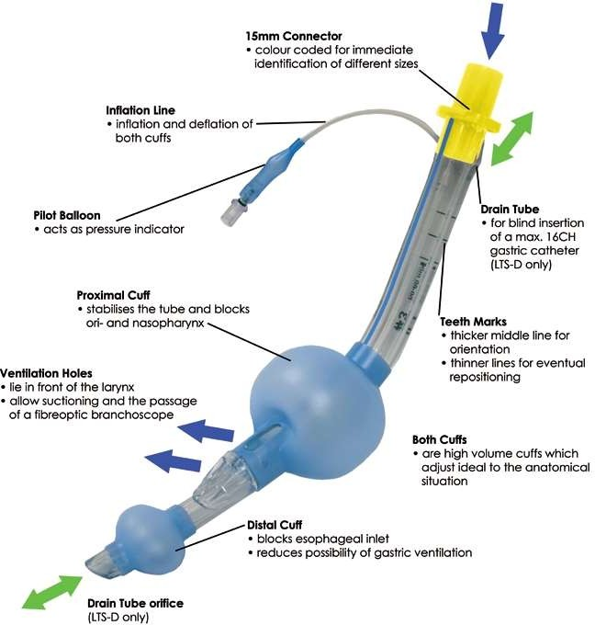
Laryngeal tube

Slide 50
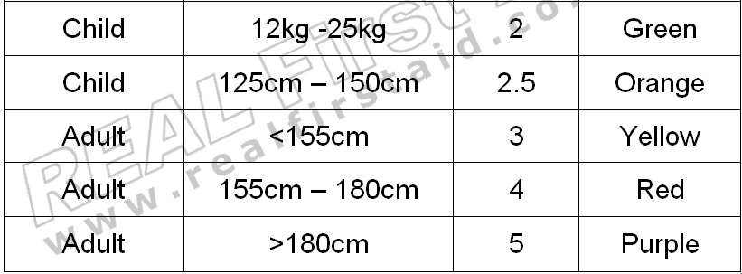
90-115cm
105-130
122-155

Slide 51
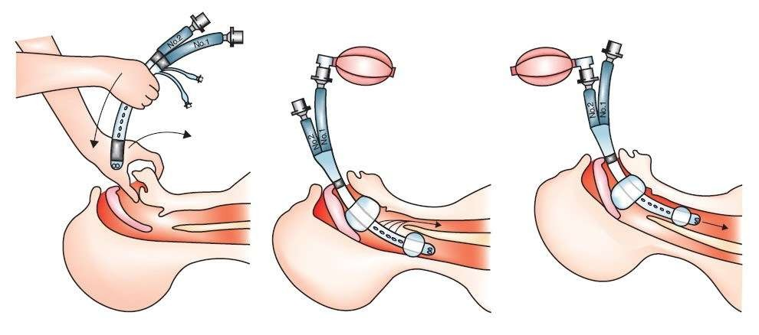
Esophageal tracheal tube

Slide 52
Pharmacotherapy

Slide 53
Routes of Administration
Peripheral IV – must followed by 20 ml NS push Central IV – fast onset of action, but do not wait or
waste time for CV line
Intraosseous – alternative IV route in peds, also in Adult
Intratracheally (down an ET tube)- not recommended now a days

Slide 54
Oxygen
IV Fluids

Slide 55
Amiodarone (Cordarone)
Indications:
Vtach, Vfib
IV Dose:
  300 mg in 20-30 ml of N/S
  Supplemental dose of 150 mg in 20-30 ml of N/S
  Followed with continuous infusion of 1 mg/min for 6 hours then .5mg/min to a maximum daily dose of 2grams
Contraindications:

Slide 56
Lidocaine
Indications:
VT, VF
Can be toxic so no longer given prophylactically
IV dose :
1-1.5 mg/kg bolus then continuous infusion of 2-4 mg/min
Can be given down ET tube
Signs of toxicity:
slurred speech, seizures, altered consciousness

Slide 57
Magnesium
Used for refractory VF or VT caused by hypomagnesemia and Torsades de Pointes
Dose:
1-2 grams over 2 minutes
Side Effects
Hypotension
Asystole

Slide 58
Propranolol/ Esmolol
Beta blocker that may be useful for VF and VT that has not responded to other therapies
Very useful for patients whose cardiac emergency was precipitated by hypertension

Slide 59
Epinephrine
Alpha, beta-1, and beta-2 stimulation
Increases heart rate, stroke volume and blood pressure
IV Dose:
1 mg every 3-5 minutes
May increase ischemia because of increased O2 demand by the heart

Slide 60
Sodium Bicarbonate
METABOLIC acidosis / hyperkalemia
Airway and ventilation have to be functional
IV Dose:
– 1 mEq/kg
Side effects:
  Metabolic alkalosis
  Increased CO2 production

Slide 61
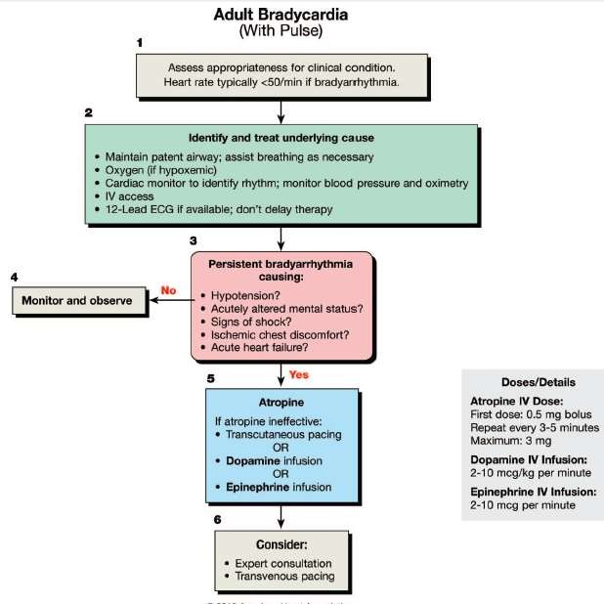

Slide 62
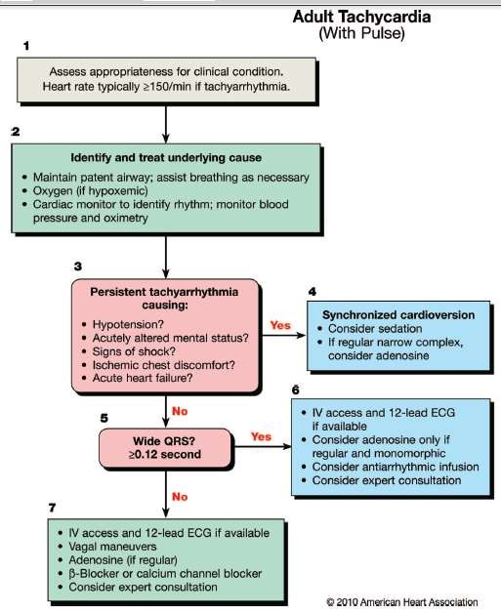

Slide 63
Synchronised cardioversion - shock delivery that is timed (synchronized) with the QRS complex
Narrow regular : 50 – 100 J
Narrow irregular : Biphasic – 120 – 200 J and Monophasic – 200 J
Wide regular – 100 J
Wide irregular – defibrillation dose
•

Slide 64
ADENOSINE
Slows conduction time through the A-V node, can interrupt the reentry pathways through the A-V node
Pottasium channel opener and hyperpolarisation
IV Dose:
6 mg rapid iv push, follow with NS flush..
Second dose 12 mg
Side effects:- Flushing of face, bronchospasm

Slide 65
Cardiac Arrest Associated With Pregnancy

Slide 66
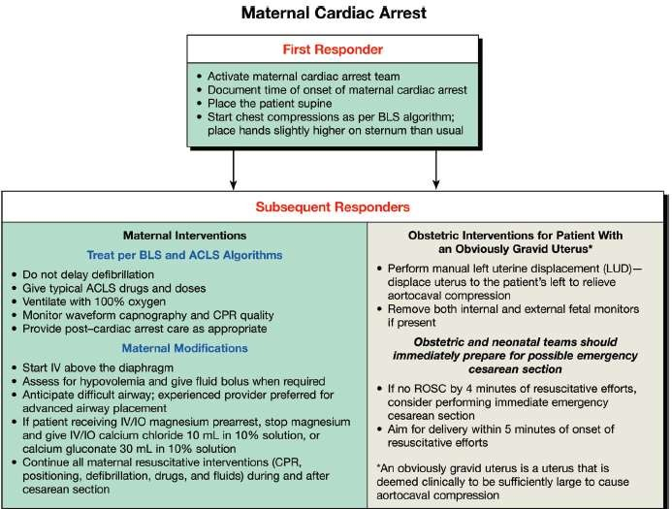

Slide 67
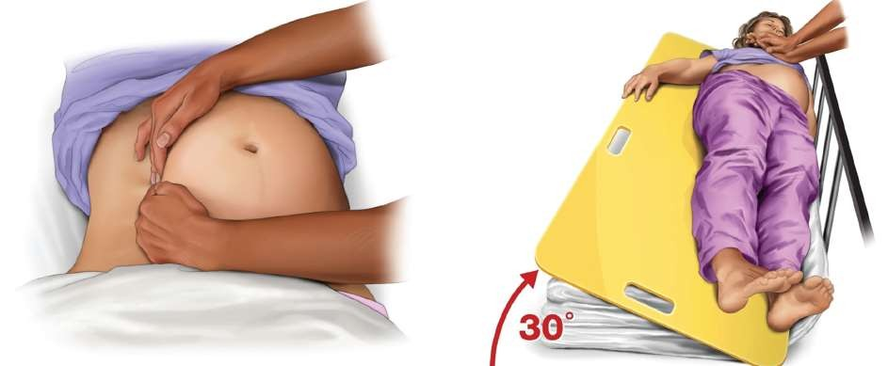
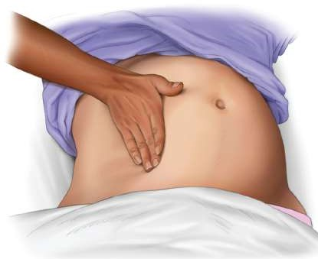

Slide 68
causes
B – Bleeding/ DIC
E – Embolism( pulmonary, coronary , amniotic ) A – Anesthetic complications
U – Uterine atony
C – Cardiac disease( MI/Aortic dissection/Cardiomyopathy)
H – Hypertension ( Pre eclampsia/ Eclampsia ) O – Other reversible causes
P – Placenta praevia/ abruptio

Slide 69
Recommendation for emergency caesarean section
Recommendation
When the gravid uterus is large enough to cause maternal hemodynamic changes due to aortocaval compression,
emergency caesarean section should be considered, regardless of fetal viability

Slide 70
POST CARDIAC ARREST CARE

Slide 71
Objectives
Optimize cardiopulmonary function and vital organ perfusion.
After out-of-hospital cardiac arrest, transport patient to an appropriate hospital with a comprehensive post–cardiac arrest treatment
Transport the in-hospital post– cardiac arrest patient to an appropriate critical-care unit
Try to identify and treat the precipitating causes of the arrest and prevent recurrent arrest

Slide 72
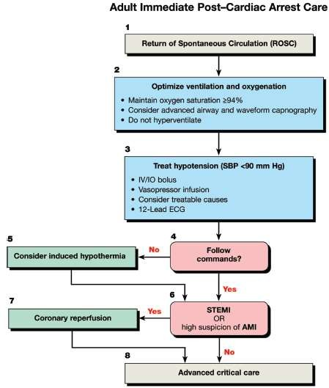

Slide 73
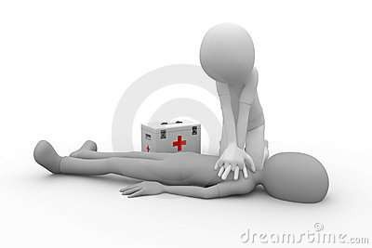
Action in time can save a
life!!!
THANK YOU

